Slide 1


CV-X-IF Project – June 2021
Trefor Southwell

Slide 2
CV-X-IF Project Concept
This project is the creation of the specification of the CV-X-IF interface between RISC-V cores and co-processors
Lead within the OpenHW Cores Task Group
CV-X-IF is the specification of a processor-co-processor interface applicable to all RISC-V cores (not only CV cores)
Leverages RISC-V ISA encoding
Accelerator-agnostic instruction offloading
Draft v0.1 driven so far by ETH Zurich available on GitHub
https://github.com/pulp-platform/riscv-extension-interface
Specification is being move to the OpenHW group

Slide 3
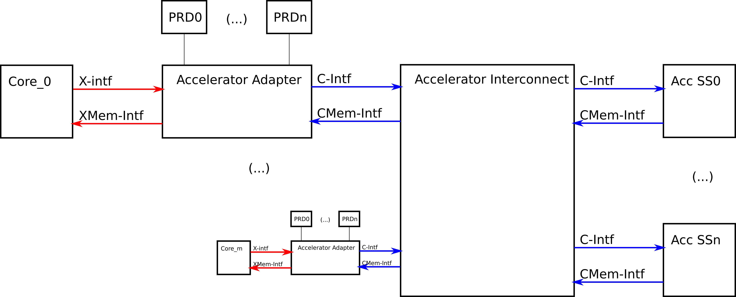
CV-X-IF Specification
Objectives
Provide a unified accelerator interface.
Decouple development of accelerators and CPU cores
Re-use extension accelerators with different cores
Share expensive accelerator units across multiple cores in a cluster
Where possible minimise the overhead (performance, area and clock frequency) of using the extension interface (compared with modifying the core internally).

Slide 4
CV-X-IF specification validation tasks
Implementation within CV32E40X core
Includes support for compressed instructions
Potential implementation in 64-bit CVA6 core
Including validating the performance and area of an external FPU
Potential use of the interface for the RV32F extension to CV32E40P

Slide 5
Project team
OpenHW - Process and coordination with other projects in openHW
Imagination Technologies - Project Manager
ETH Zürich - Initial 0.1v draft and feedback to help achieving 0.9 draft
Yosys HQ - Formal specifications to help achieving 1.0 draft
Embecosm – Compiler
Thales – Feedback from CVA6 and RV64 ISA.
SiLabs - CV32E40X implementation
University of Bologna – Exploring X-interface for XPULP_NN ISA custom extensions

Slide 6






CV-X-IF Project Components: Phase 0
0
Spec definition driven by ETH with inputs from
SiLabs, YosysHQ, and lowRISC
11.2020
0.1
ETH releases v0.1
06.2021

Slide 7

CV-X-IF Project Components: Phase 1
0.1
04.2021
HW implementation feedback
CV32E40P RV32F ext
Ibex for RV32B ext
CV32E40P PULP NN ext
CVA6 RVFD ext
0.9
10.2021

Slide 8

CV-X-IF Project Components: Phase 2
0.9
10.2021
Final feedback
CV32E40X
Formal Spec
Compilers
1.0
OpenHW Group releases v1.0
06.2022

